Slide 1

I-69 Congressional Caucus Briefing
Moving American Freight and
Creating Economic Opportunity
I-69 DC Fly-In 2019
Delegation Representing the Eight-State Corridor

Slide 2
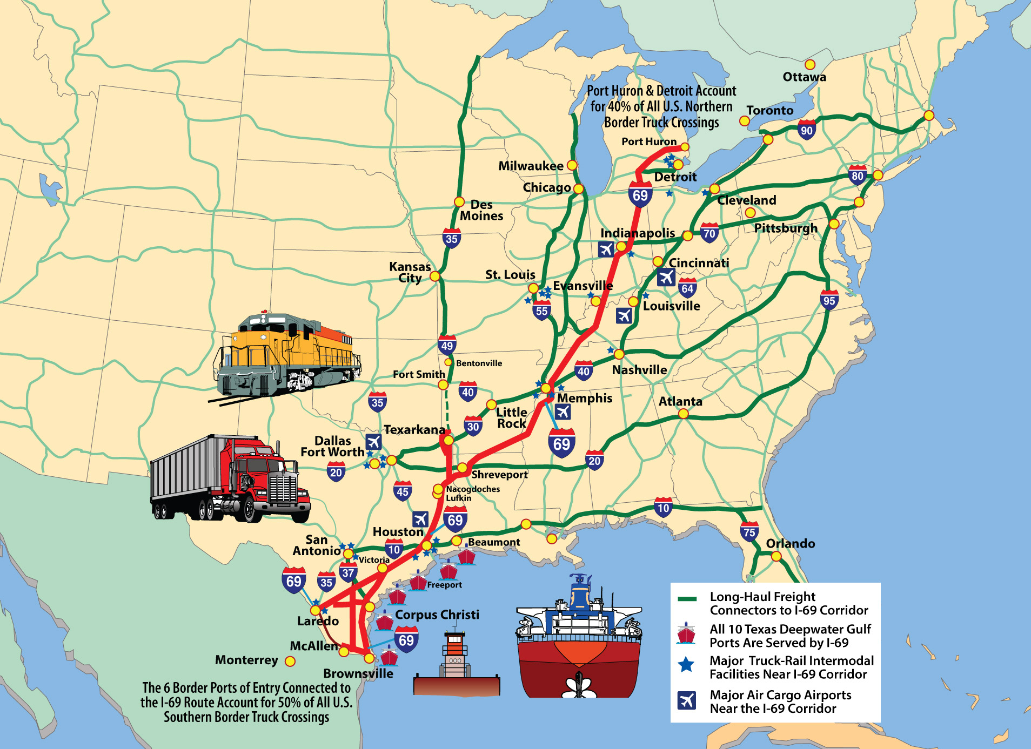

Moving American Freight and
Creating Economic Opportunity

Slide 3


Texas

Slide 4
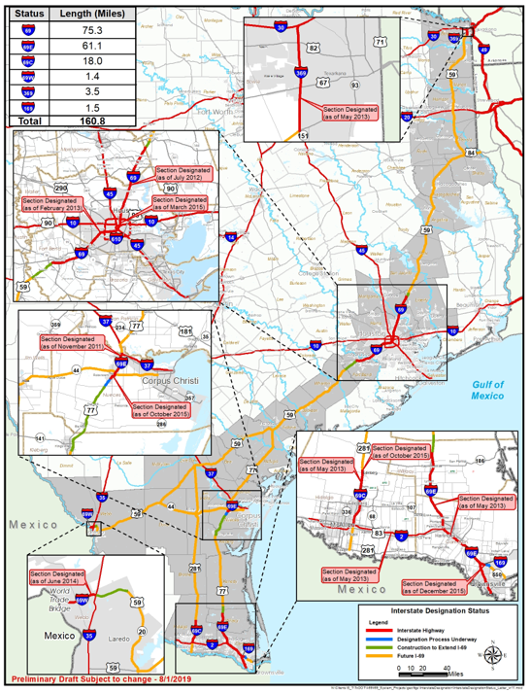
Route Map – Texas
We have approximately 161 miles of I-69 system highways designated as interstate.
We are working with AASHTO and FHWA to designate two highway sections totaling approximately 5.8 miles.
When completed, the system would be approximately 1,100 miles long.
Notes:
REFERENCE THE BULLETED ITEMS ON THE SLIDE

Slide 5
Status of Projects, Miles and Funding
I-69 Texas funding commitments
39 Projects are funded and in design to upgrade highways to interstate standards.
$2,715,942,894 is committed as of August 2019 for those 39 projects.
Approximately $4 billion has been committed to upgrade highways to interstate standards since September 1, 2010.
Over $2 billion is committed to upgrade already designated I-69 sections in the Houston area.
Voters overwhelmingly approved two propositions that provide additional funding for transportation projects statewide.
Approved in 2014, Proposition 1 allows a portion of oil and gas tax revenues that typically go into the Economic Stabilization Fund to be deposited to the State Highway Fund.
This year, the Texas Legislature approved legislation extending the expiration date of Proposition 1 ten years to December 31, 2034.
Approved in 2015, Proposition 7 allows portions of revenue from the state’s general sales and use tax, as well as from the motor vehicle sales and rental tax to be deposited to the State Highway Fund for non-tolled projects.
Notes:
REFERENCE THE BULLETED ITEM ON THE SLIDE, AUGMENTED BY ANY ADDITIONAL NARRATIVE DESIRED

Slide 6
Related Developments
Last month, the Texas Transportation Commission approved the Unified Transportation Program (UTP), identifying $77 billion in planned investments statewide over a 10-year period, including projects and studies for the I-69 system.
Within the past 12 months, TxDOT completed two detailed planning studies evaluating approximately 30 miles of I-69 system highways to upgrade to interstate design standards.
TxDOT is also conducting a number of studies recommended in the 2018 Texas Freight Mobility Plan including,
Texas Statewide Truck Parking Study
Freight Design Considerations Study
Texas-Mexico Border Transportation Master Plan
Notes:
REFERENCE THE BULLETED ITEMS ON THE SLIDE, AUGMENTED BY ANY ADDITIONAL NARRATIVE DESIRED

Slide 7

Louisiana

Slide 8

Interstate 69
Connecting Port of Caddo-Bossier with I-49
www.dotd.la.gov

Slide 9
Background
Not enough dedicated funding is available to construct any useable segment of the I-69 mainline in Louisiana.
Establishing a connection between Port of Caddo- Bossier and I-49 may be feasible.
EIS calls for a frontage road on north side of I-69 connecting Stonewall Frierson Road with Ellerbe Road.
FHWA has indicated the remaining I-69 earmarked funds can be used for the frontage road.
9

Slide 10
Funding Available
The earmarked funds remaining are as follows:
$ 2,749,779.72 unobligated
$ 8,974,323.40 IOU unobligated
$ 1,087,179.09 remainder unexpended on SIU’s 14 & 15
$12,811,282.21 total federal
$ 3,202,820.55 non-federal match
$16,014,102.76 total available for Frontage Road
10

Slide 11
11

Slide 12
12

Slide 13
Next Steps
With formal concurrence from NLCOG, Desoto Parish, and Caddo Parish, including CEAs on ownership, DOTD can begin project development for the frontage road.
Currently “re-evaluating” the EIS to show that nothing significant in the area has changed.
Need to determine scope and estimate for upgrading Stonewall Frierson Road and for upgrading/extending Robson Road through a feasibility study of each.
May request federal matches on the service road concepts outside of existing I-69 SIU-15 Frontage Road

Slide 14

Arkansas

Slide 15
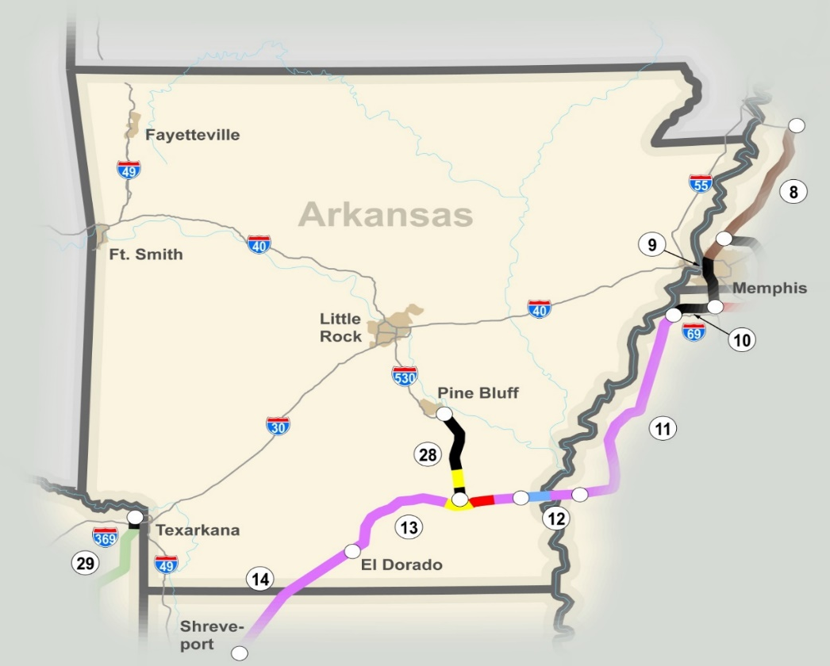
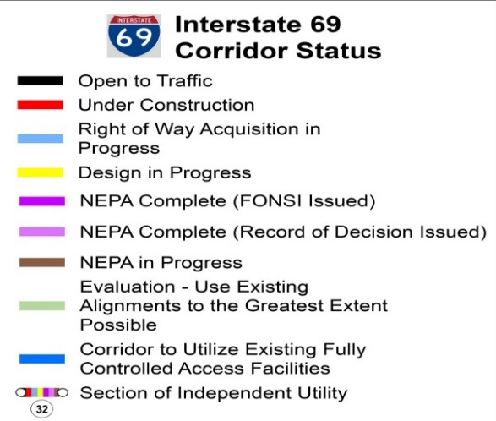

Arkansas Route Map
Preferred Alignment Identified
184 miles
Estimated Cost to Complete - $3.3 Billion
4 “Segments of Independent Utility” (SIUs)
Federal Earmarked Funds - $300 Million
Notes:
The environmental phase of the I-69 corridor in Arkansas is complete and a preferred alignment has been identified.
The Interstate 69 Corridor in Arkansas crosses the Mississippi River into Arkansas just north of Arkansas City. It will continue westward staying south of Monticello and north of El Dorado before turning southwestward to Shreveport, Louisiana – it essentially runs along the southern border of Arkansas. The I-69 Connector (Future I-530) will provide a connection from Interstate 530 in Pine Bluff to the I-69 Corridor near Monticello.
The total estimated cost to construct approximately 184 miles of Interstate 69 in Arkansas is $3.0 billion. The mileage and cost include 1) the I-69 Connector – 42 miles and $616 million; and 2) Arkansas’ portion of the Great River Bridge – 16 miles and $910 million.
There are 4 “Sections of Independent Utility”
Arkansas has received over $300 million in earmarked funding for this corridor.

Slide 16
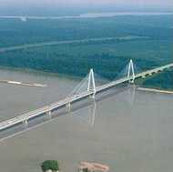
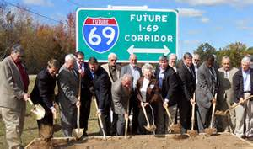
Status of Projects, Miles and Funding
Status | Miles | Total (millions)
Complete | 37.6 | $ 212
Under Construction | 0.0 | $ 0
Scheduled | 17.0 | $ 69
Unfunded | 129.4 | $ 3,037
Totals | 184.0 | $ 3,318
Notes:
REFERENCE THE BULLETED ITEM ON THE SLIDE, AUGMENTED BY ANY ADDITIONAL NARRATIVE DESIRED

Slide 17
Latest Developments
Monticello Bypass
Monticello to McGehee
Two Lanes Scheduled
For Early 2023
Right of Way Acquisition Under Way
Two Lanes Complete
Notes:
The most active segment of the I-69 Corridor in Arkansas is the eastern part of SIU 13 near Monticello, Arkansas. The preferred alignment in this area was to construct a bypass to the south of Monticello.
Two lanes of bypass are complete on the eastern side
The western side of the bypass is funded in Arkansas’ STIP for right of way acquisition and will be constructed in the future as funding becomes available.
Construction for the first two lanes of the corridor between Monticello and McGehee is scheduled to begin in early 2023.
Right of way will be purchased for the ultimate four-lane facility
In Arkansas’ STIP for $69 million

Slide 18

Mississippi

Slide 19

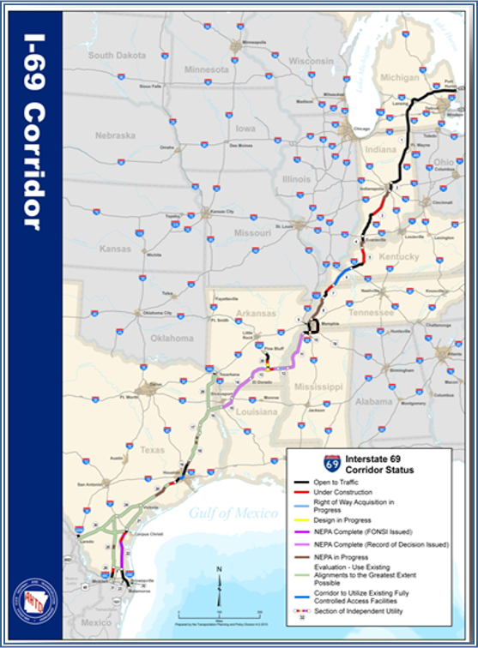




*
Canada to Mexico
2,730 miles
Estimated Cost to Complete - $30 Billion
Congressionally Designated High Priority Corridors 18 & 20
Identified by Sections of Independent Utility (SIUs)
Includes I-69 Connector(s)
* Images courtesy of ArDOT

Slide 20
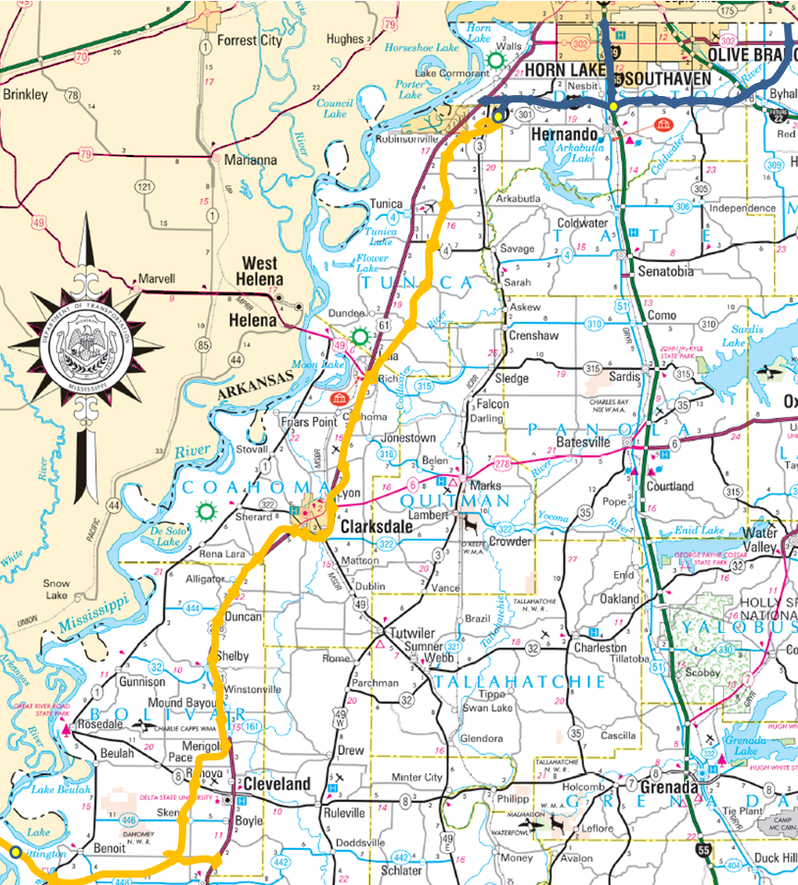

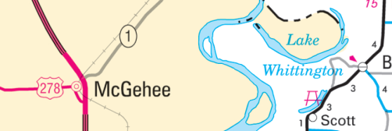
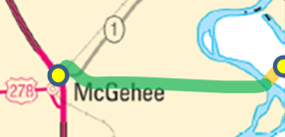

SIU 9
SIU 10
testy
Completed & Open to Traffic
Unfunded Portions
ArDOT Portion
SIU Limits
SIU 11
I-69 in Mississippi
SIU 12

Slide 21
Funding
Status | Miles | Total (in millions)
Completed | 65 | $731.4
Under Construction | 0 | $0.0
Unfunded | 113 | $1,827.0
Totals | 178 | $2,558.4

Slide 22
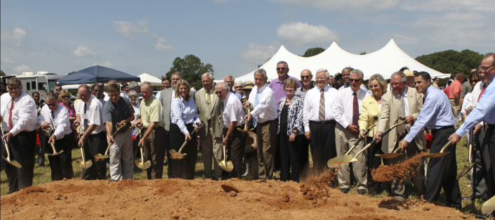
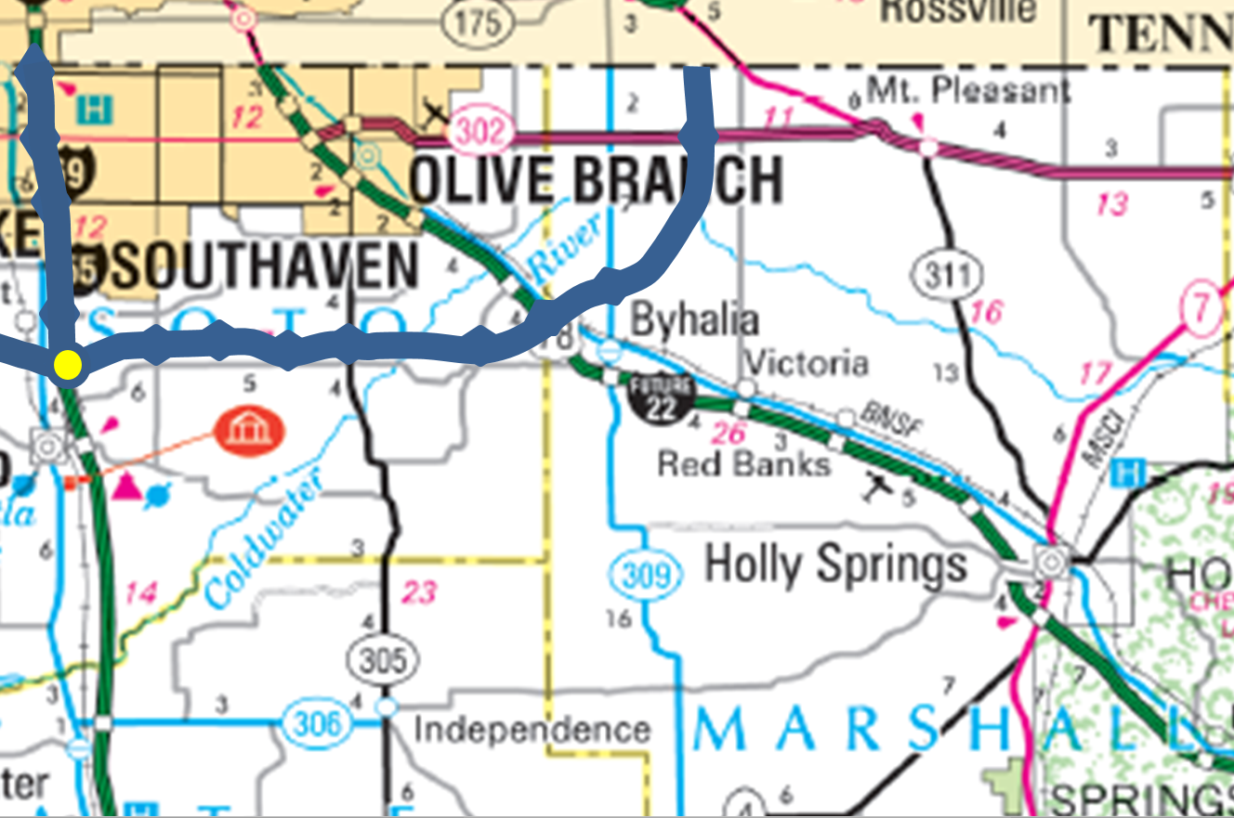
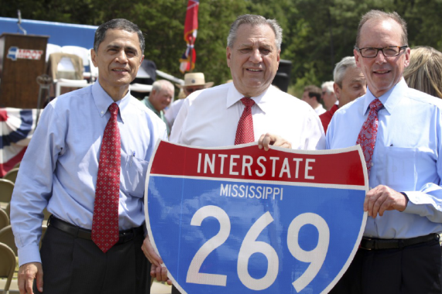
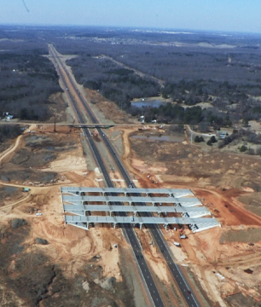
SIU 9
Completed and Open to Traffic SIU Limits

Slide 23
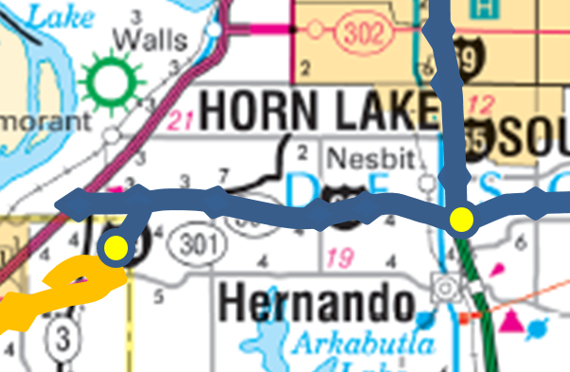

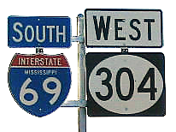
SIU 10
Robert Lee (10/08/06)
Completed and Open to Traffic Unfunded Portions SIU Limits

Slide 24
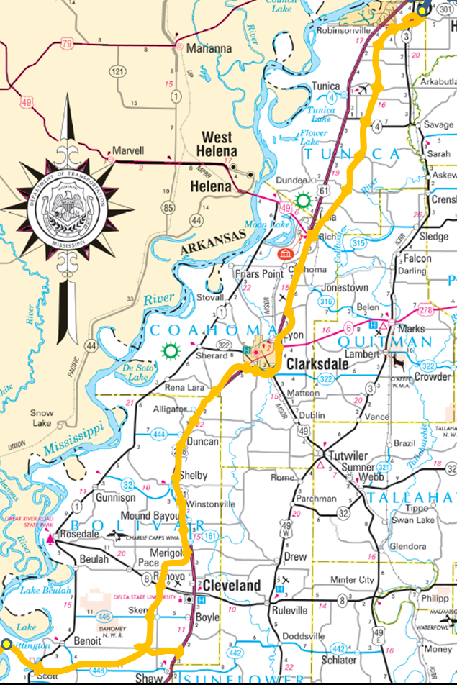
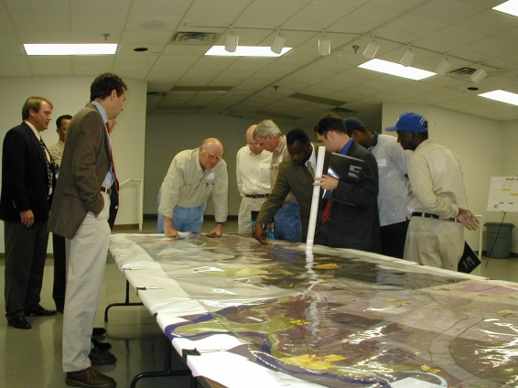
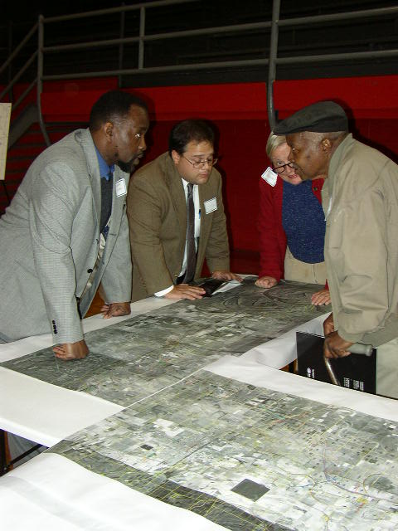
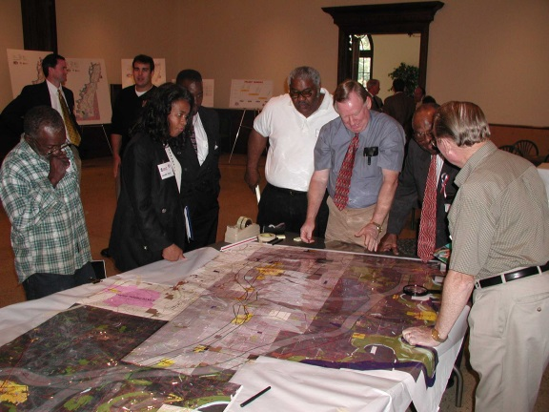
SIU 11
Unfunded Portions SIU Limits

Slide 25
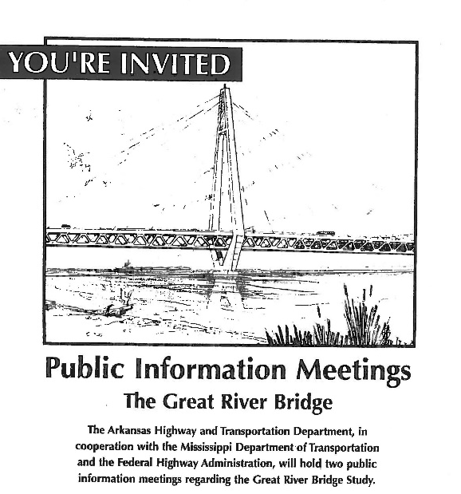
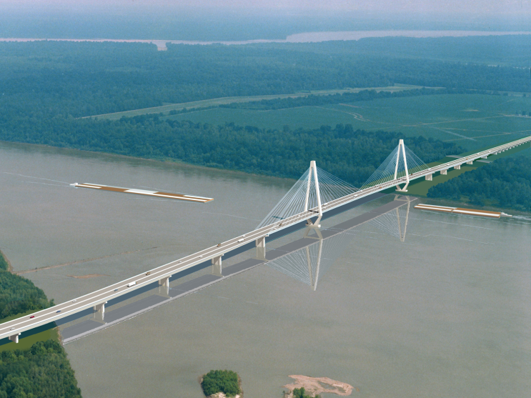
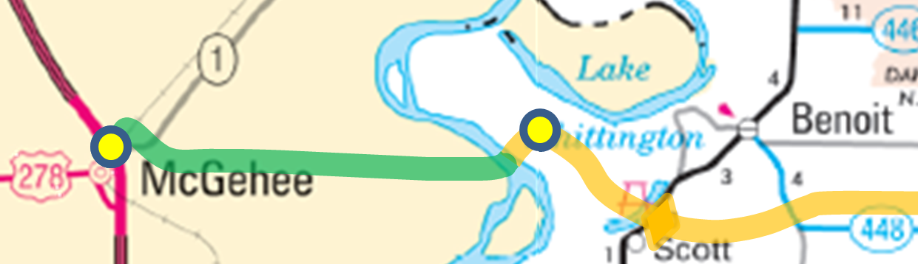
SIU 12
*
*
ArDOT Portion Unfunded Portions SIU Limits
* Images courtesy of ArDOT

Slide 26

Tennessee

Slide 27
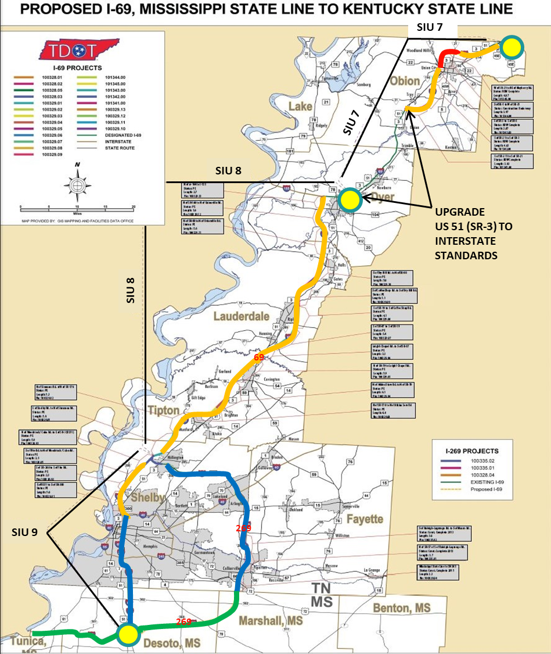
Tennessee Route Map
Completed & Open to Traffic
Under Construction
Portions with Unfunded Phases
MDOT Portion
SIU Limits (7,8 & 9)
Notes:
REFERENCE THE BULLETED ITEMS ON THE SLIDE

Slide 28

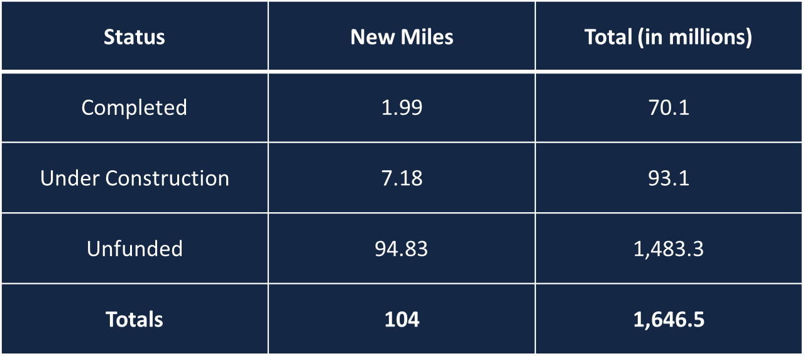
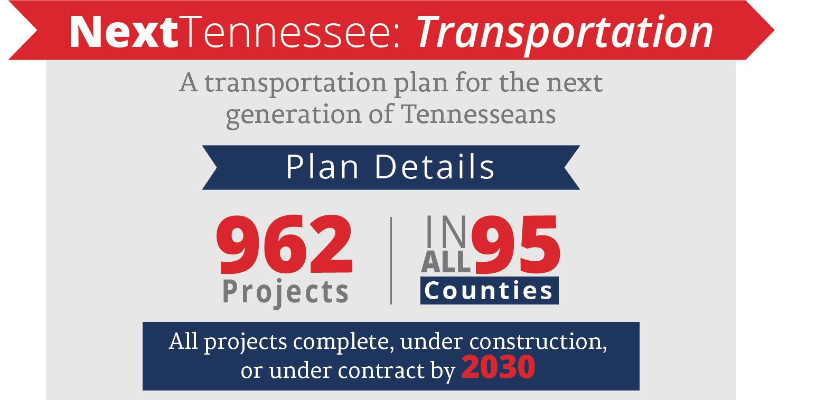
Status of Projects, Miles and Funding
TOTAL MILES OF I-69 INCLUDED IN IMPROVE ACT: 42.76
TOTAL ESTIMATED COST TO COMPLETE I-69 PROJECTS INCLUDED IN IMPROVE ACT: $553,418,608
Notes:
REFERENCE THE BULLETED ITEM ON THE SLIDE, AUGMENTED BY ANY ADDITIONAL NARRATIVE DESIRED

Slide 29
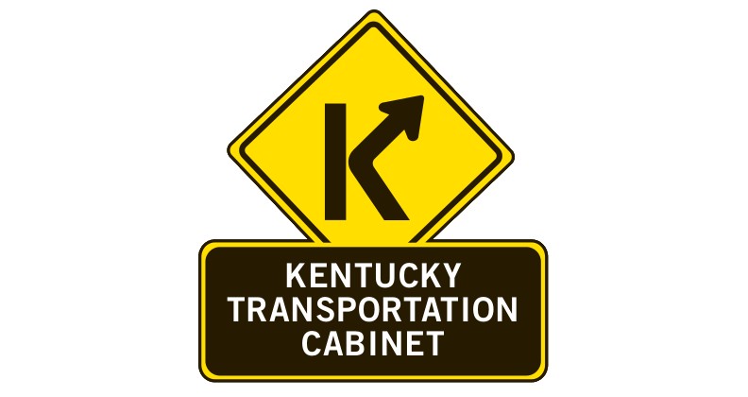
Kentucky

Slide 30
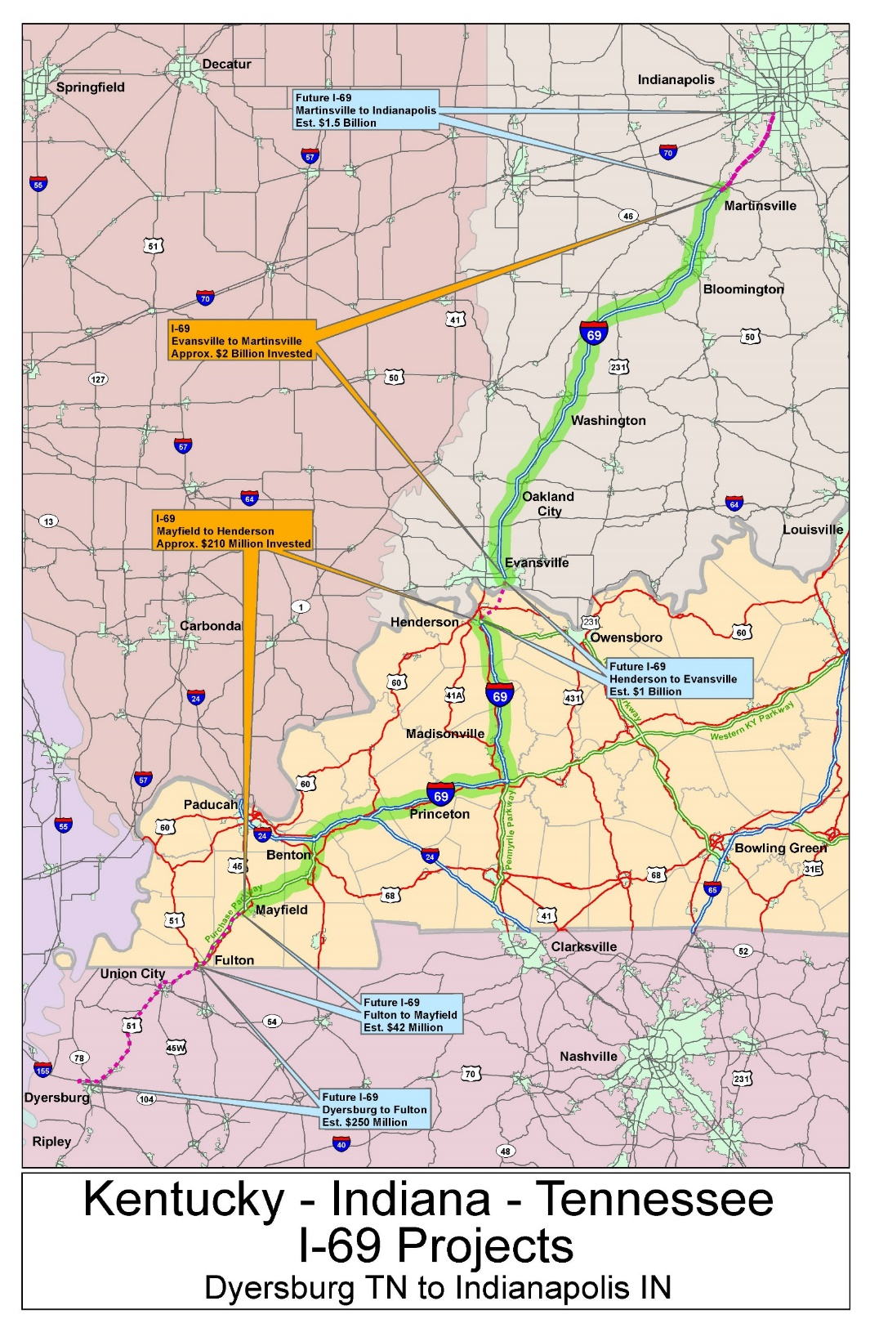

Indianapolis
Martinsville
Interstate 69
Both Kentucky and Indiana have made major investments in the I-69 corridor
Recent improvements extend from Mayfield, KY to Martinsville, IN
Evansville
Henderson
Mayfield
Fulton

Slide 31

Kentucky Progress
128 miles of I-69 are in place from Mayfield to Henderson investing $210 million modernizing former Parkways
19 miles of modernization between Fulton and Mayfield in design phase
Upon completion of these 19 miles, only ties to Tennessee in the south and Indiana to the North remain
KY/TN bi-state effort south of Fulton is wrapping up the environmental phase
I-69 Ohio River Crossing bi-state effort with Indiana will complete the environmental phase by early 2020

Slide 32

Indiana

Slide 33
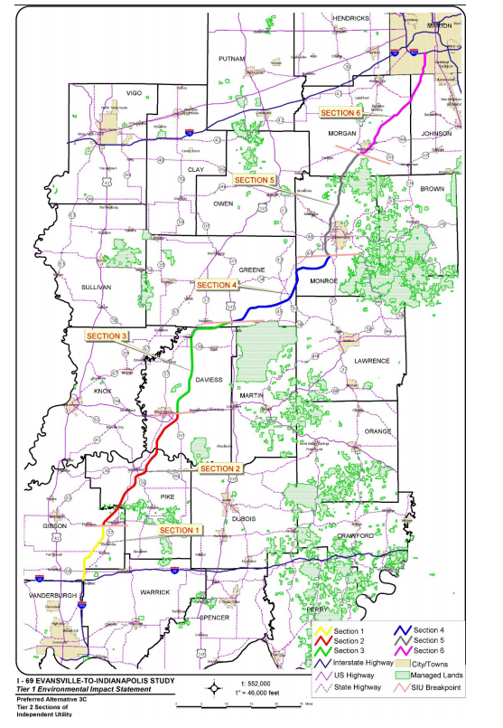

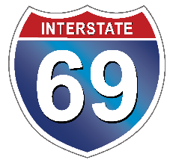
Indiana Route
Indianapolis
Evansville
Notes:
REFERENCE THE BULLETED ITEMS ON THE SLIDE

Slide 34
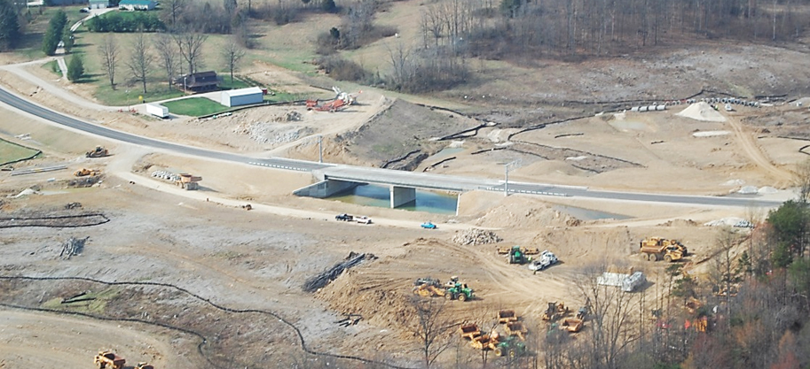
Progress: Sections 1-5
Sections 1-3
67 miles: I-64 to US 231 near Crane opened November 2012
Section 4
27 miles: US 231 to SR 37 opened December 2015
Section 5
21 miles: Bloomington to Martinsville completed October 2018

Slide 35
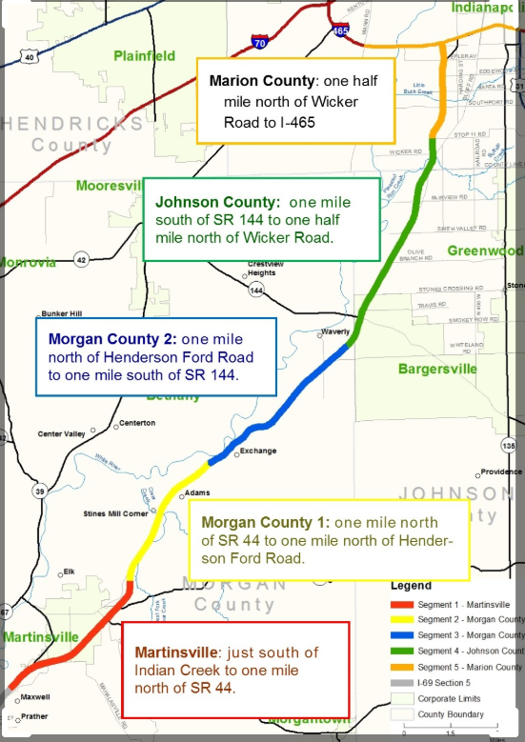
Progress: Section 6
Section 6
26 miles: Martinsville to Indianapolis
Estimated to Cost $1.5B
Construction on mainline to begin early 2020
Accelerated completion date of 2024

Slide 36
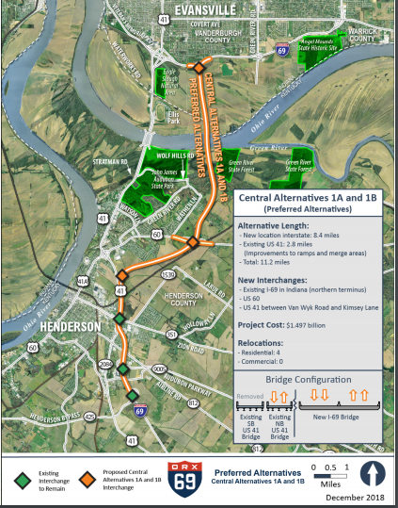
I-69 Bridge Update
Ohio River bridge will provide a critical link between the two states at Evansville and Henderson.
Draft EIS was published in December 2018.
Two preferred alternatives announced based on the same route but different tolling options for each.
ROD expected in mid-2020.

Slide 37

Michigan

Slide 38
I-69 Through Michigan Is Already A Top North American Freight Route
The I-69 Port Huron/Sarnia border crossing is one of the busiest in North America
831,000+ commercial trucks used the Blue Water Bridge in 2018 (5th most)
3,100+ commercial trains used the Canadian National double-stack rail tunnel in 2018 (4th most)
The freight passing through Michigan is linked closely to both Canada and Mexico, as these two countries are our top trading partners
This linkage can be found in every other state along I-69, demonstrating a critical need for one continuous route between all three countries to improve logistics

Slide 39
The Need to Connect I-69 From Canada to Mexico is Evident
All states along I-69 are a top trading partner to one or both of the countries, demonstrating a critical need for one continuous to improve logistics.

Slide 40

The Need to Connect I-69 From Canada to Mexico is Evident
All states along I-69 are a top trading partner to one or both of the countries, demonstrating a critical need for one continuous to improve logistics.

Slide 41
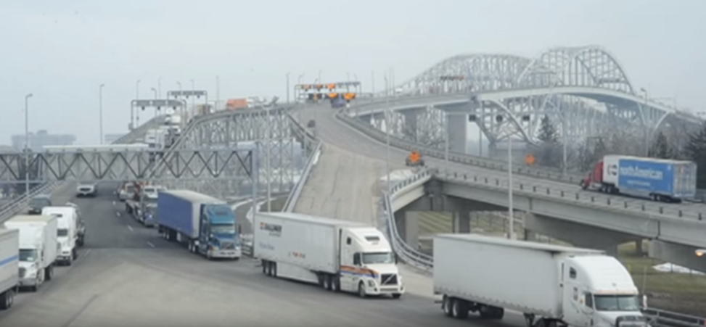
Michigan’s Top Federal Needs for I-69
We are already built out, and fully support other states’ funding requests to complete their needed construction projects
We do need funding to complete the Blue Water Bridge customs plaza in Port Huron (estimated at $165 million) to reduce major trucking bottleneck at the border

Slide 42
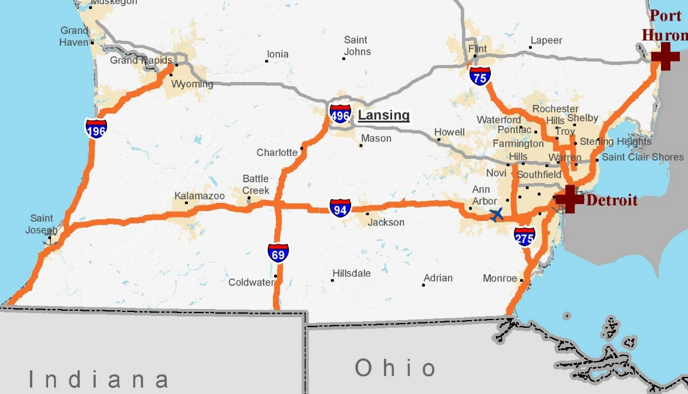
Michigan’s Top Federal Needs for I-69
125 miles of I-69 from Port Huron to Lansing was not included in the Primary Highway Freight System by the US Department of Transportation
This restricts access to federal transportation resources
Last modification made in 2015, and can be changed every five years
We need the 125 miles added in 2020
Integrate with designation as a Corridor of Highest Significance in Michigan DOT’s new Mobility 2045 transportation plan

Slide 43
I-69 Congressional Caucus Briefing
Moving American Freight and
Creating Economic Opportunity
I-69 DC Fly-In 2019
Delegation Representing the Eight-State Corridor

